Slide 1
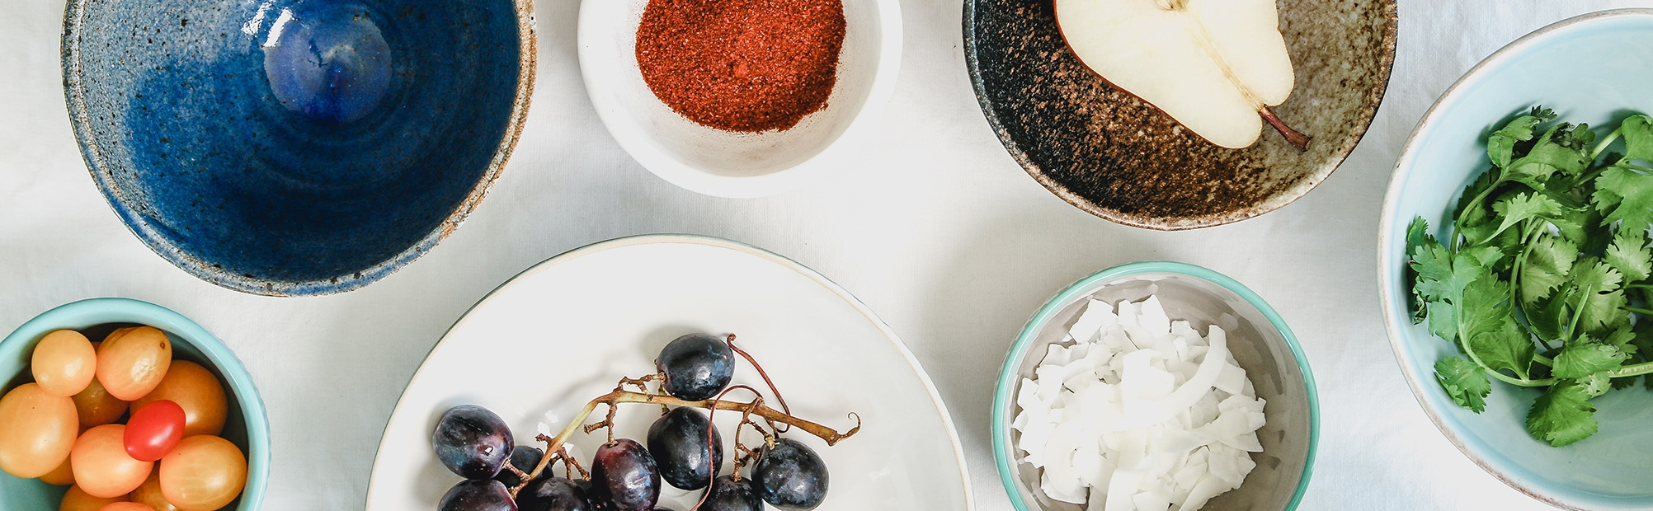
Project Milestone 3: Impact of Covid on Our Eating & Drinking Habits
Amit Saxena
Department of Data Science, Bellevue University
DSC 500 - T301: Introduction to Data Science

Slide 2
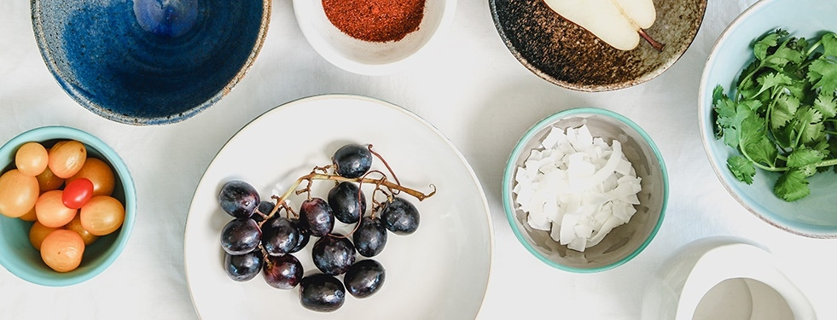
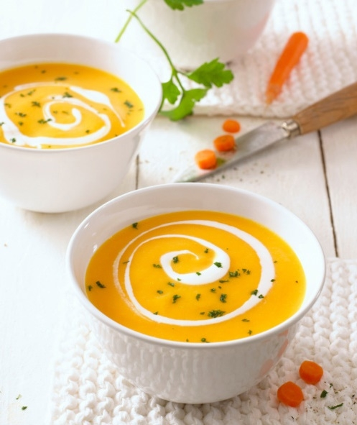
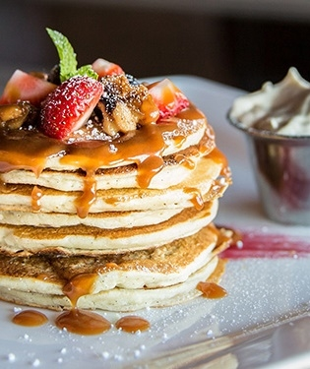
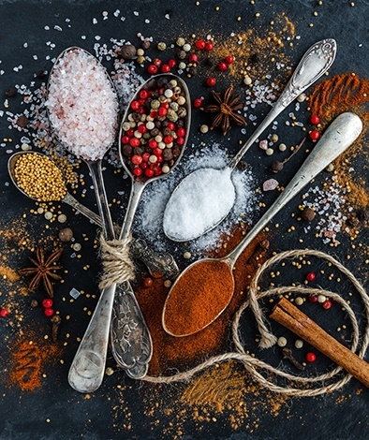
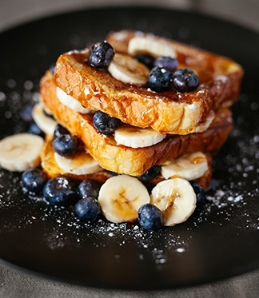
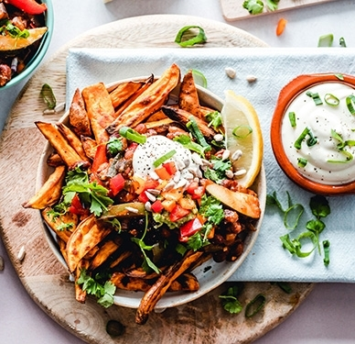
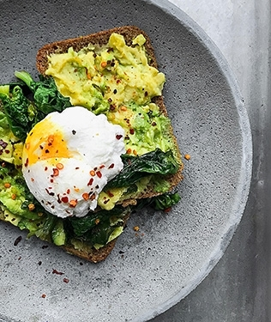
Ahi Mango and Poke Salad
Agenda
Overview
Analysis
Findings
Conclusion
References

Slide 3

Overview
COVID-19
Towards the end of 2019 and beginning of 2020, a new disease caused by a virus called coronavirus (SARS- Cov2) started in China, and quickly spread across the world as a major pandemic.
I conducted an analysis of coronavirus’ impact on our eating and drinking habits and followed the steps below:
Prepared a list of certain key words I thought would be, directly or indirectly, related.
Explored the trends of those terms and came to an initial conclusion that Covid has adversely impacted our eating and drinking habits.
To substantiate my findings, I started reviewing studies conducted on these topics as a follow up to the initial research.

Slide 4
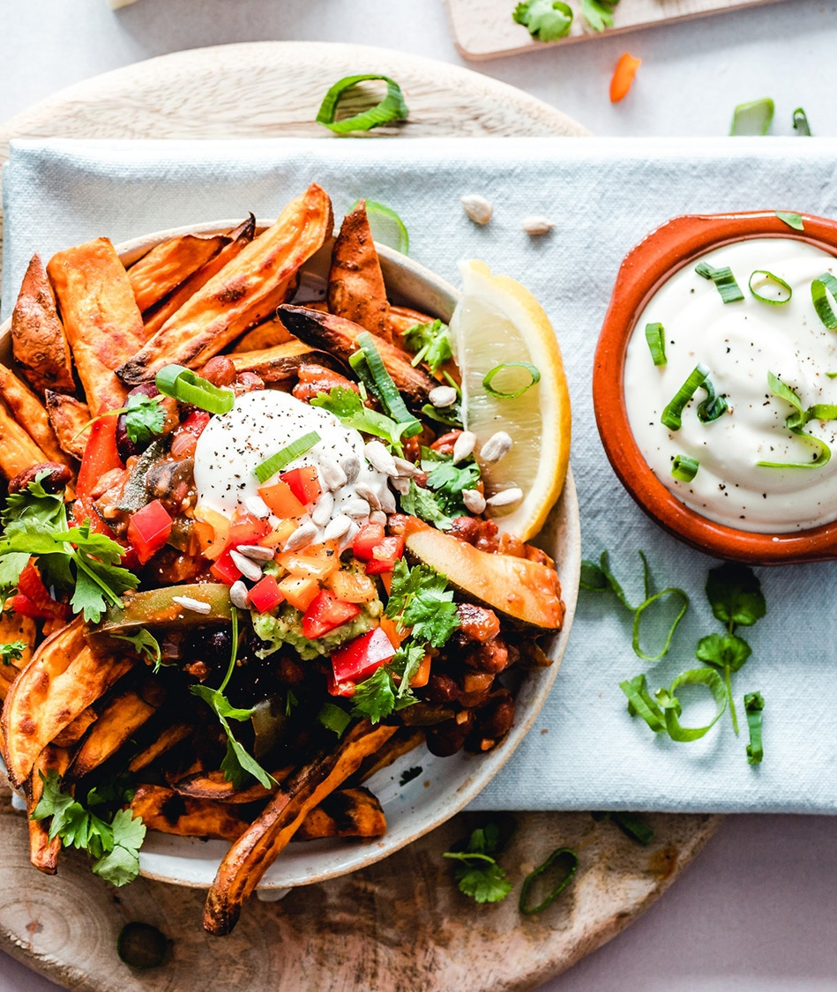
Analysis- Study Based
I reviewed five studies conducted on impacts Covid had on food and drinks. Below is a summary of my review:
1st study conducted in UK concluded that the purchase of calories increased during Covid leading to obesity rates.
2nd study compared eating habits while working from office vs home and found that working from home was associated with weight increase and diet-related health problems.
3rd study focused on children and adolescents and the result showed increased consumption of home cooked food as well as sweets.
4th study focused on Twitter and found increased tweets related to healthy food and decreased tweets on fast food.
5th study focused on alcohol and opioid related deaths and found a sharp increase in both.

Slide 5

Analysis- Google Trends Based
My initial research was based on the Google trends of some key words from Jan 2019 till Mar 2023, and following were my observations:
The trend was upwards for ready to eat meals indicating more people searching for easy meals.
Searches for liver disease symptoms and hepatologist went up.
Searches for key words acid reflux and heartburn went up.
Search for wight loss trended up.
Searches for gyms went up.

Slide 6
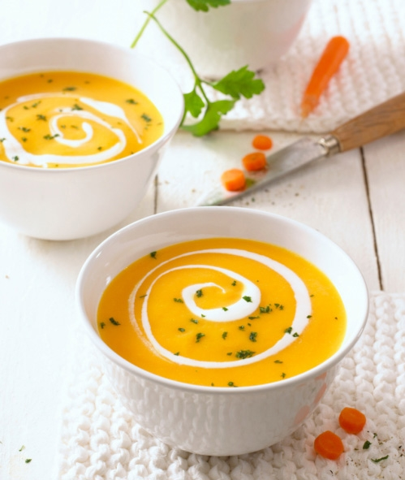
Findings- Eating Habits
My findings on eating habits based on the studies and trend analysis are:
More home cooked meals due to closure of restaurants and people spending more time at home.
Increase in casual snacking and increase in sugar intake.
Availability of groceries and financial capacity of families to buy grocery products impacted eating habits.
Some families depended on ready to eat and cheaper options due to constrained financial conditions (loss of job due to pandemic).

Slide 7
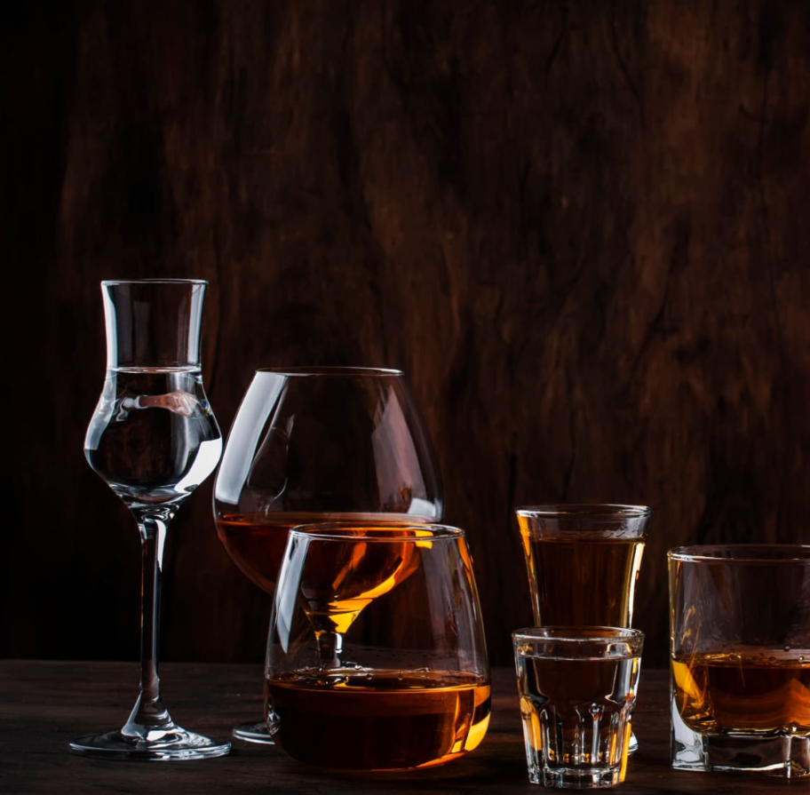
Findings- Drinking Habits
My findings on drinking habits based on the studies and trend analysis are:
Data indicates alcohol-related deaths increased approximately 25% between 2019 and 2020.
The number of opioid overdose deaths increased 38% in 2020.
Similar increases observed in number of deaths in which alcohol contributed to overdoses of opioids (40.8%) and synthetic opioids (59.2%).

Slide 8
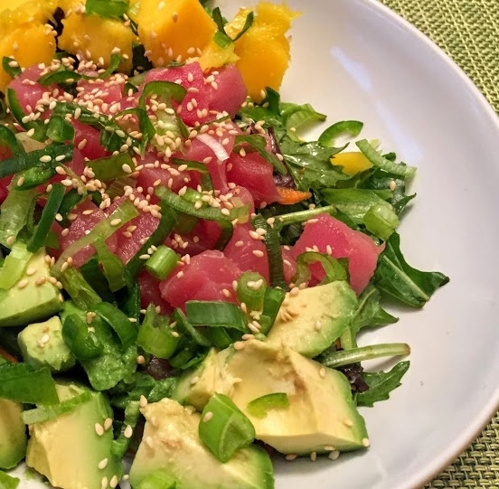
Conclusion
Based on the studies I reviewed and observing Google trends of some key words, following are my conclusions:
Eating Habits:
The result are inconclusive on our eating habits and further studies need to be undertaken to fully understand how Covid impacted our eating habits.
In the future there will be data on post Covid habits, which can be compared with pre Covid habits to get a clear picture.
Drinking Habits:
There seems to be evidence that our drinking habits have deteriorated during the pandemic.

Slide 9
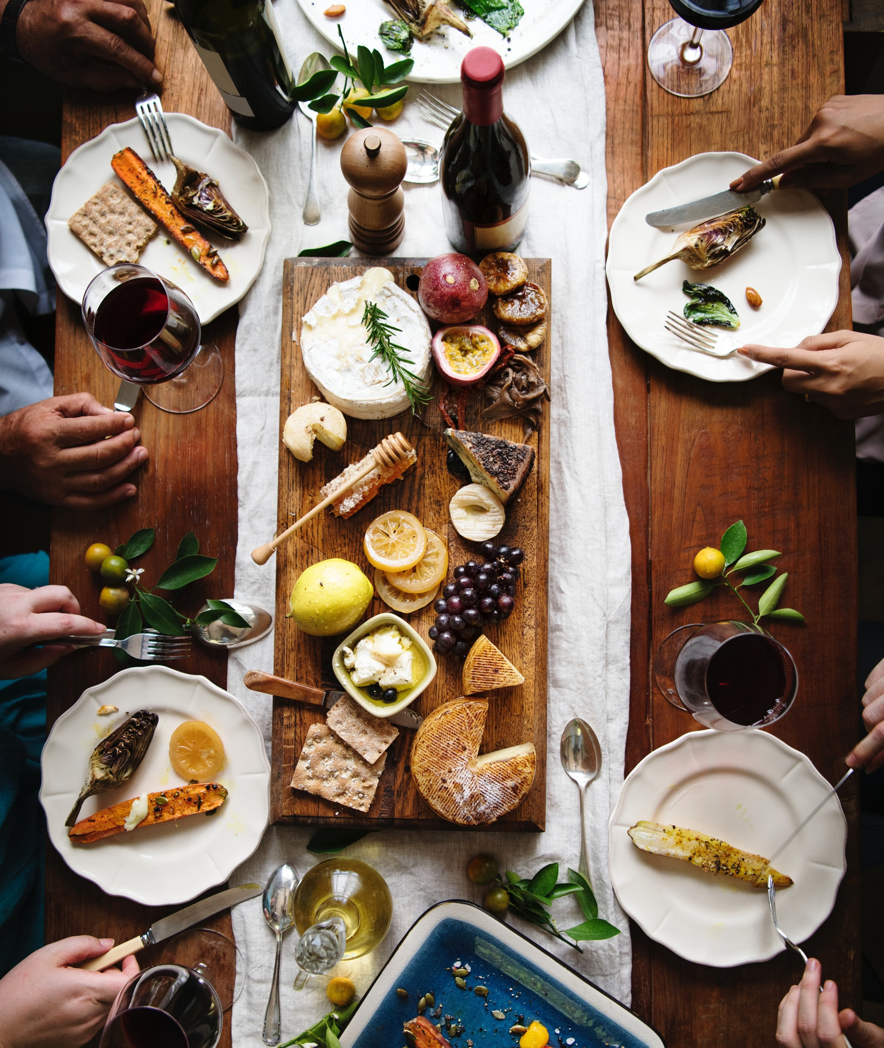
References
Coronavirus Resource Center. John Hopkins University & Medicine- https://coronavirus.jhu.edu/region/united-states
WHO website- https://www.who.int/health-topics/coronavirus#tab=tab_1
The dietary impact of the COVID-19 pandemic (2022). Science Direct- https://www.sciencedirect.com/science/article/pii/S0167629622000601
Dietary habits during the COVID-19 pandemic. Are work environments part of the problem? (2022). Frontiers Website- https://www.frontiersin.org/articles/10.3389/fsufs.2022.961908/full
Eating habits of children and adolescents during the COVID-19 era: A systematic review (2022). Website of National Library of Medicine- https://www.ncbi.nlm.nih.gov/pmc/articles/PMC9623566/#s5title
Diet during the COVID-19 pandemic: An analysis of Twitter data (2022). Patterns website- https://www.cell.com/patterns/fulltext/S2666-3899(22)00152-0#secsectitle0040
Alcohol-Related Deaths During the COVID-19 Pandemic (2022). JAMA Network website- https://jamanetwork.com/journals/jama/fullarticle/2790491

